Slide 1
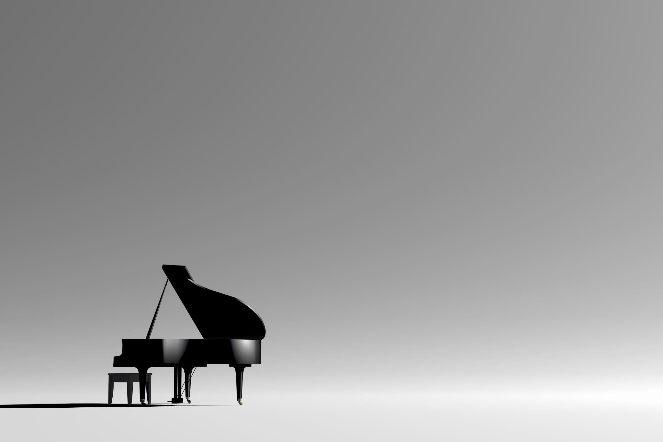
Piano recognition -
Travis Osgood
Brendon Williams
Caleb Hart
Joshua Aguayo
Parker Pratt

Slide 2
What It Is
The program’s main goal is to distinguish/recognize certain songs being played.
It can distinguish between pianos and general background noise, even hearing the piano in the noise.
This was made possible thanks to combining noise reduction methods like Wiener filtering and spectral subtraction, using advanced algorithms like Dynamic Time Warping (DTW) and multi-pitch analysis.

Slide 3
Background & Prior Work
Existing methods have been used to reduce noise in sounds, such as Wiener filtering, wavelet transform and improved spectral subtraction. Ma, S. (2023). A comparative study of multiple music signal noise reduction algorithms in music processing. Noise &amp; Vibration Worldwide, 54(6), 291–296. https://doi.org/10.1177/09574565231179732
There are other forms of mathematical music analysis, such as Markov note recognition algorithms and Fast Fourier Transform. Fu, T. (2022). "model of markov‐based piano note recognition algorithm and Piano Teaching Model Construction". Journal of Environmental and Public Health, 2022(1).https://doi.org/10.1155/2022/6045597

Slide 4
Background & Prior Work Cont.
Finally, we’ve seen Convolutional Neural Networks also be used to distinguish piano music, but we don’t have the resources to run one. Girbés Mínguez, J. (2021). Piano Note Recognition: Classification Aided by Convolutional Neural Networks [Review of Piano Note Recognition: Classification Aided by Convolutional Neural Networks]. https://riunet.upv.es/bitstream/handle/10251/182214/Girbes%20-%20Reconocimiento%20de%20Notas%20de%20Piano%20Clasificacion%20Usando%20una%20Red%20Neuronal%20Convolucional.pdf?sequence=1&isAllowed=y

Slide 5
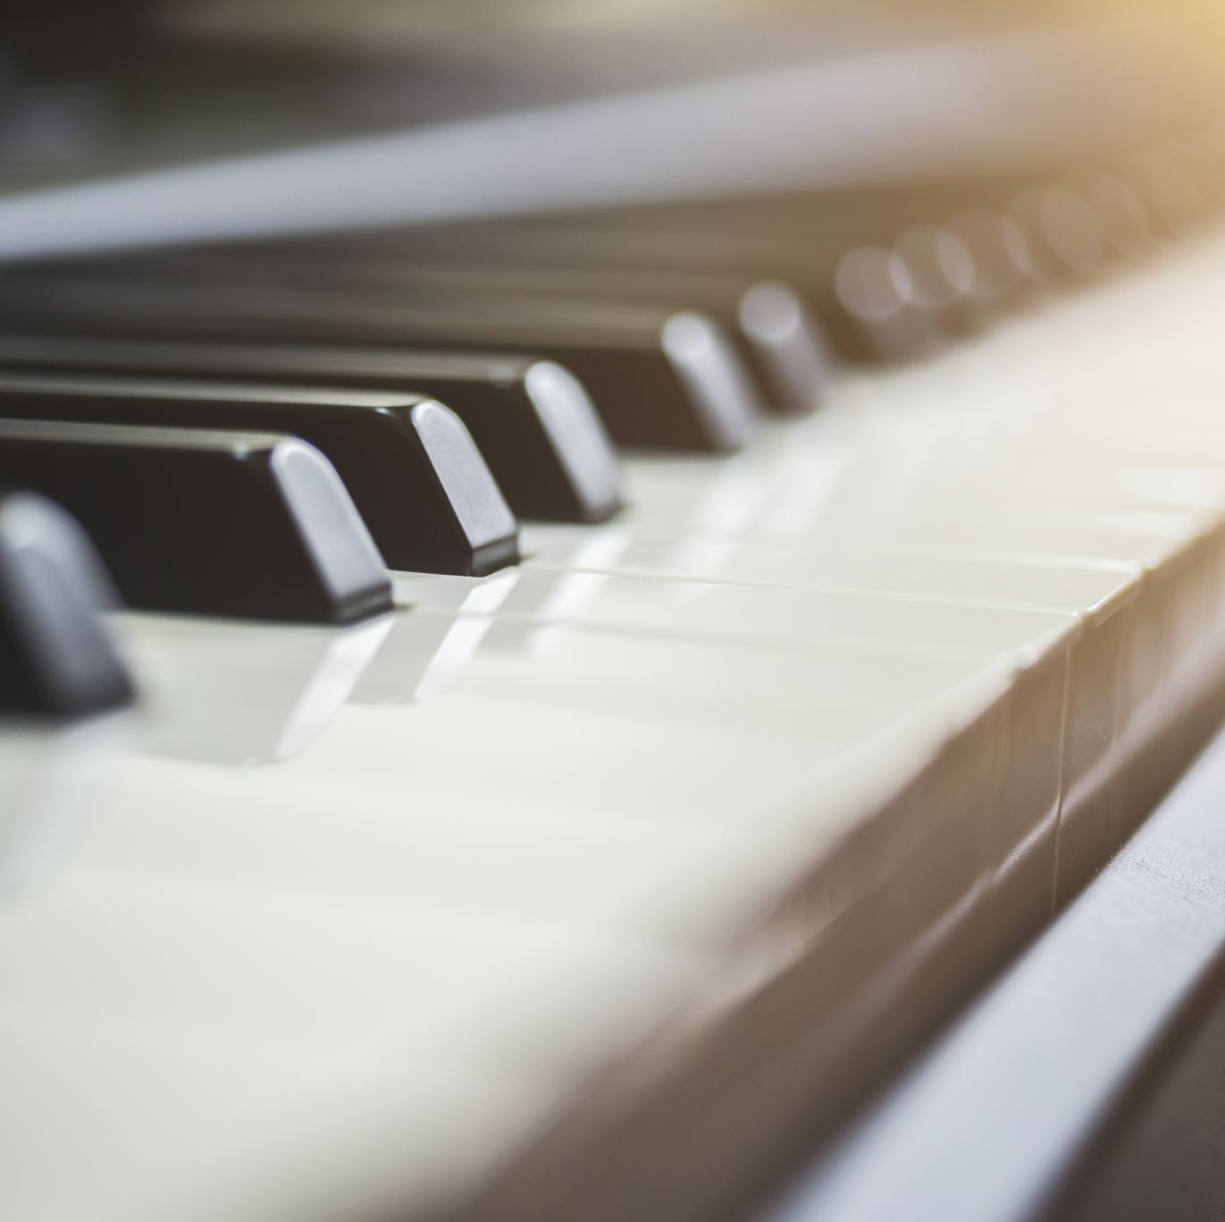
Our Model
Our work was trained and tested on synthesized and real-world examples of piano music which we used for robust real-time music transcription

Slide 6
Data Sources & Acquisition
Our training dataset used in this project was MusicNet, obtained through Kaggle
MusicNet is a bunch of MIDI audio files, perfectly synced to their notes
Our testing dataset was a bunch of .wav files scraped from YouTube
This way, when we broke down these .wav and took the notes, we could compare to a perfectly sanitary version of the song
Finally, we would pull our Kaggle dataset from Google Drive, where it would eventually be used for our Piano Recognition

Slide 7
Data Processing & Pre-Processing
First, we would pull all our .wav training/testing files together so that we can access them easily later
Second, we had to convert the training/testing .wav files into mfcc files. These would be saved to a .pkl file for quicker reuse later.
Third, we would “denoise” the audio and use Euclidean distance or DTW to determine the distance of the various forms of denoising from our dataset

Slide 8
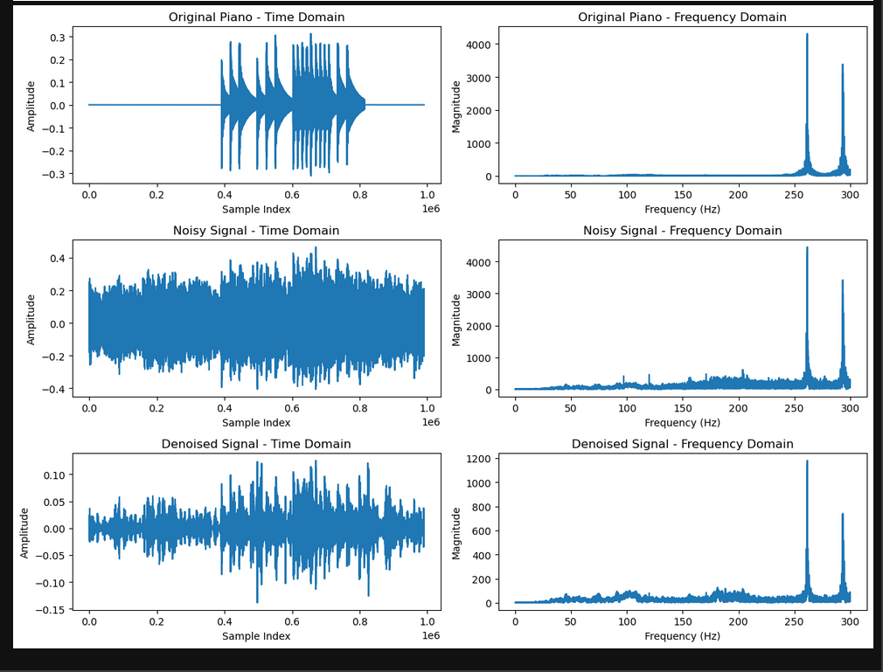
Feature Extraction – Audio Representations
From our .wav files, several key features are extracted. These include waveform representation, spectrograms, and Mel-frequency cepstral coefficients (MFCCs).
Taking these MFCCs, we can break apart audio into arrays of data. This would make it possible to display or do arithmetic
Then, we display the sound clips of the data to show our noise reduction methods and how they can bring a sound back to it’s original “shape”.

Slide 9
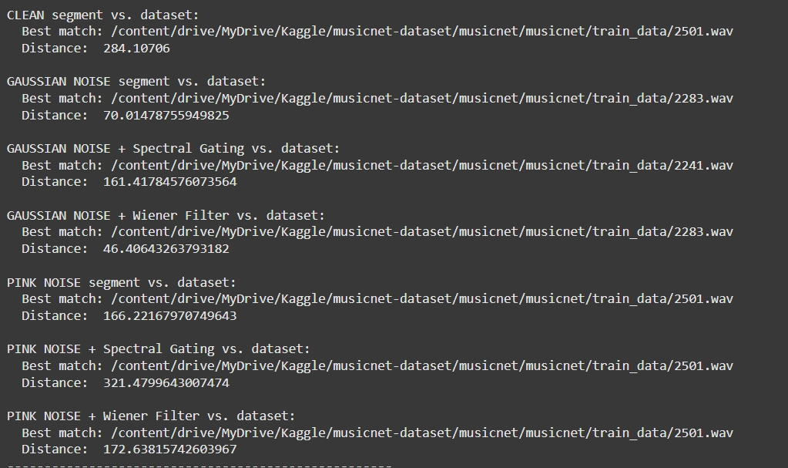
Dynamic Time Warping (DTW) & Sequence Alignment
With the MFCCs we would make from the inputted audio, we would do Euclidean Distance over Dynamic Time Warping because calculations to determine the distance between it and all our training data; due to our data being continuous
Dynamic Time Warping is used for situations where an audio clip’s tempo might not match our training data, but the structure of it is similar
In the end, we find that both distance calculation methods became vital in getting accurate distance measurements, but chose Euclidean.

Slide 10
Noise Handling & Robustness Techniques
To allow for more randomized testing, we introduced gaussian noise functions into our code to distort our testing clips when gathering simulator accuracy.
In our code, we mainly used 2 forms of denoising. Wiener filter and spectral gating were the best methods we had to denoise audio clips
In the end, with all the modifications to the audio, hamming distance became very difficult to use and therefore replaced by Euclidean Distance in our code

Slide 11
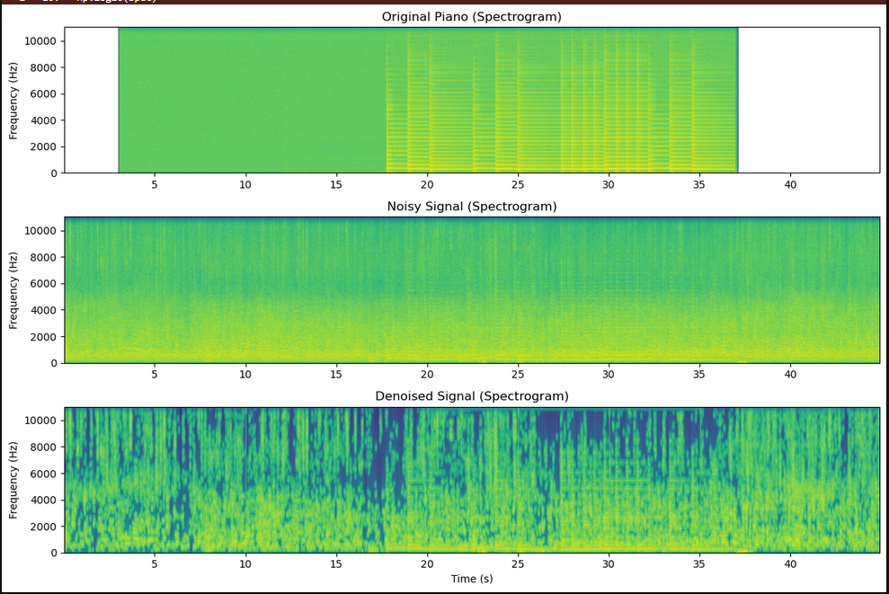
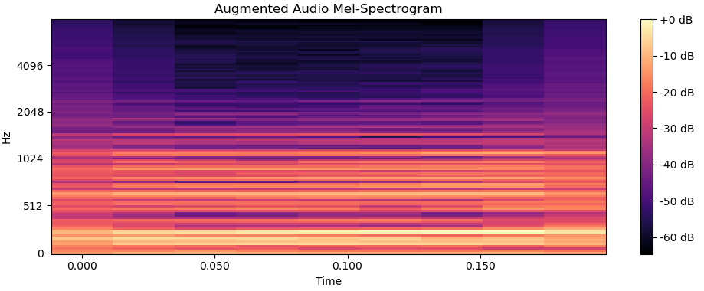
Visualization Techniques – Audio Feature Plots
Spectrogram
Waveform: Raw audio amplitude over time. Seen in the feature extraction slide
Spectrogram: Frequency content displayed in decibels (dB) with a log-scaled Y-axis.
MFCCs: Compact representation of the spectral envelope. Usually displayed in a Mel-Spectrogram itself
MFCC
Waveform

Slide 12
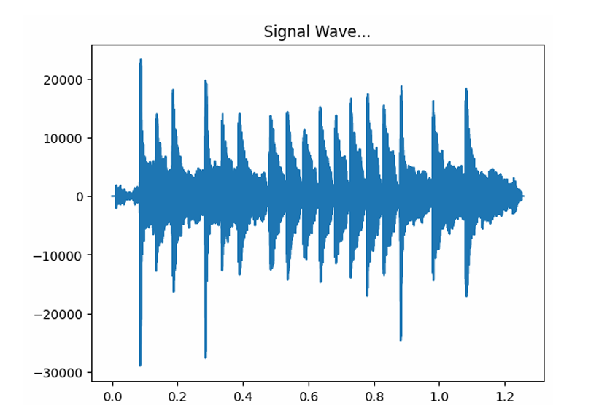
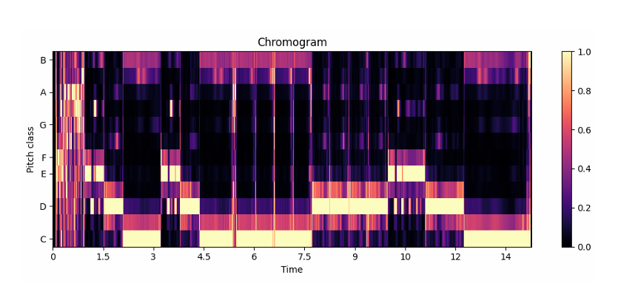
Advanced Visualization – Tonal & Temporal Analysis
Chromogram: Mapping audio to 12 pitch classes for harmonic structure analysis.
Signal Wave: Visual representation of frequency in hertz.

Slide 13
Feature Comparison & Classification
DTW allowed us to find the most similar audio clips even with heavily modified copies of the music.
We used the Librosa provided version of DTW, and we had to break apart the MFCC files to get the correct shape for use with DTW in order to get accurate readings on the distance.
Finally, we sort an array of distances, and take the top match, optionally we could also return a path to the best match to our tested audio.

Slide 14
Evaluation Metrics:
Euclidean Distance
- Euclidean distance measures the straight-line distance between two points in multidimensional space. It’s based on the Pythagorean theorem and is most effective for highly correlated data.
Hamming Distance
- Hamming distance measures the number of positions at which two strings of equal length differ for signal processing. It's mostly used for categorical or binary data, which makes it difficult to implement for continuous signals.

Slide 15
Future Development & Research Directions
For future development, a big addition would be a larger data set and better functions to get more separation between the piano’s noise and the other noise in the background.
Pitch estimation through Vibrato could be a big help to improving functionality of a piano recognizer. With extra data from other ideas like past pitch tracking, we could further improve networks of information on accurately guessing music.
Finally, introducing music theory could help in the long run with code involving music as a whole. Being able to understand music and how it works could provide great insight into improvements on recognition.
Signal compression or stretching noise to make better use of DTW.

Slide 16
Thank You!

